Slide 1
Credit EDA Case Study
By Ayush Anand

Slide 2
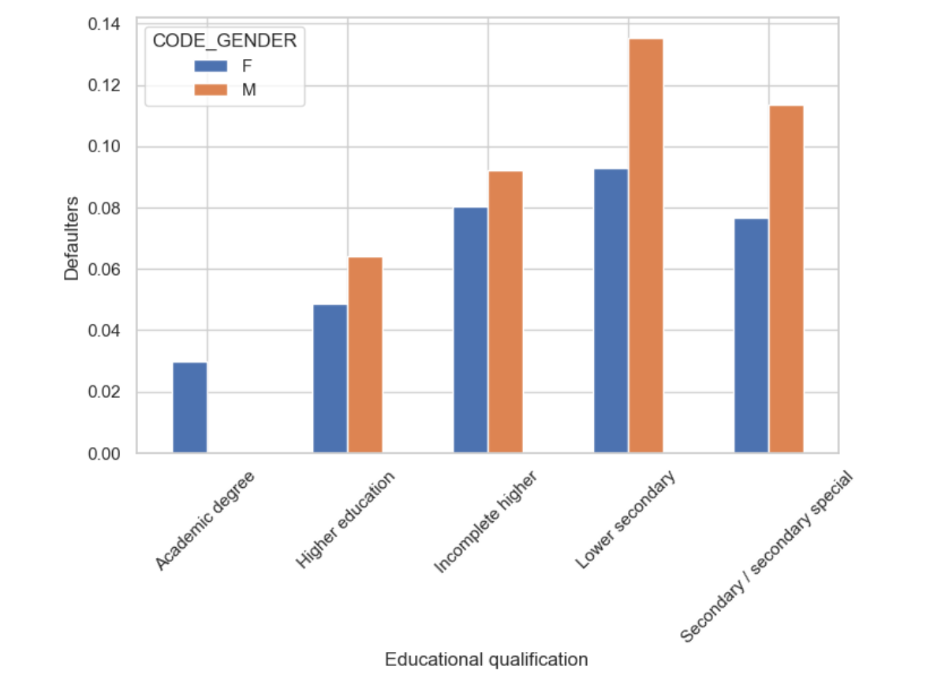
Current applications analysis
Conclusion:
- Clients with Higher education are less defaulted and Lower secondary ones are likely to be more defaulters
To target:
- It is safe to target higher educated clients across all other groups

Slide 3
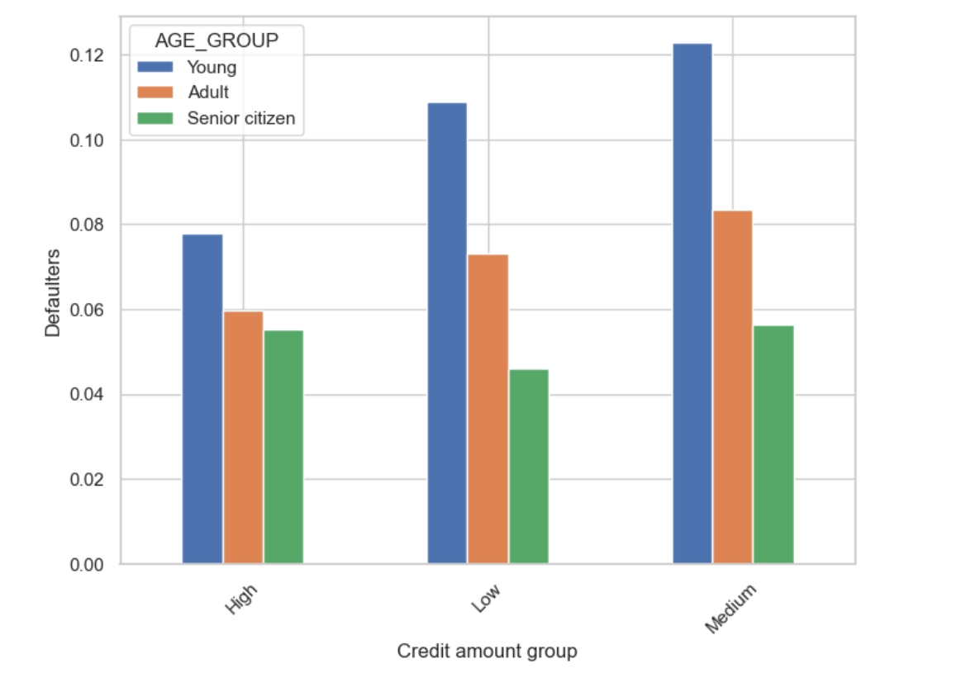
Conclusion:
- Highly defaulted are Young clients with medium and low credit amount group
- Less likely defaulted are Senior citizens across all credit amount groups
To target:
- Safe to target Senior citizens across all credit amount groups

Slide 4
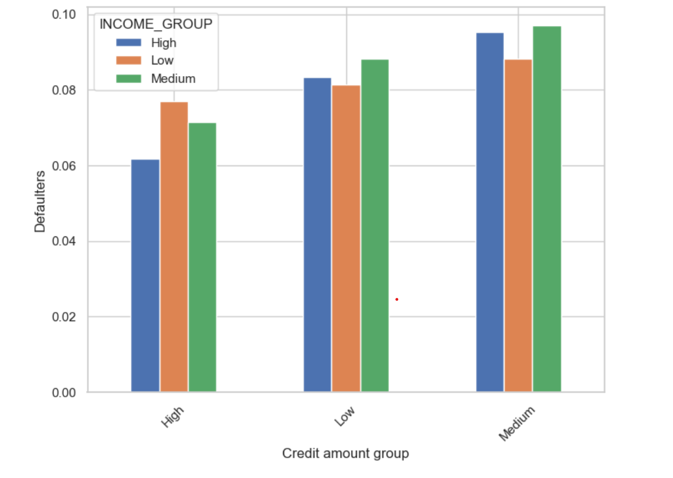
Conclusion:
- Highly defaulted in all income groups are Medium credit amount group
- In all income groups High credit amount groups are less likely to default
To target:
- Grant higher amount of loan to all income groups

Slide 5
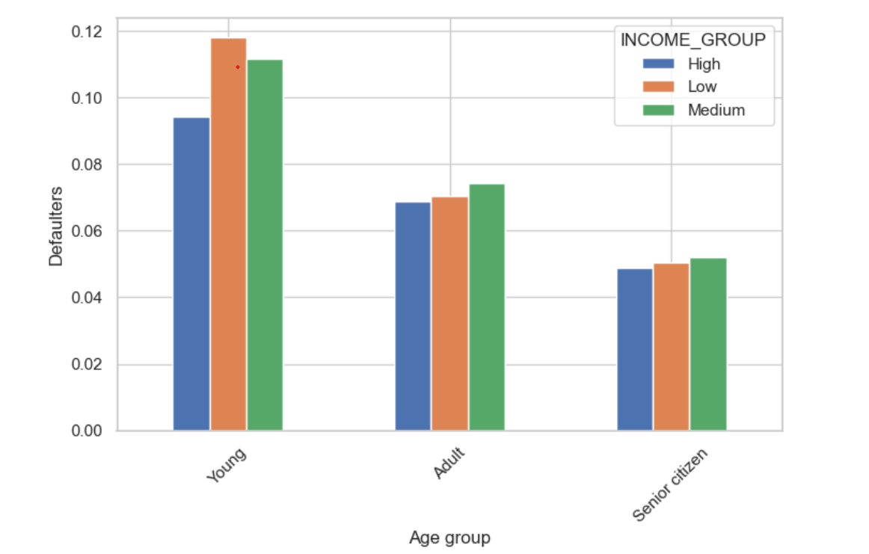
Conclusion:
- Young clients are more defaulted than Mid age and senior
- Young low income people are more defaulted
- Default rate is almost same in all income group for Mid age and senior people
To Target:
- Safe to grant loan to Senior citizen and Adult with higher income
- Risky to grant loan to Young ones with low income

Slide 6
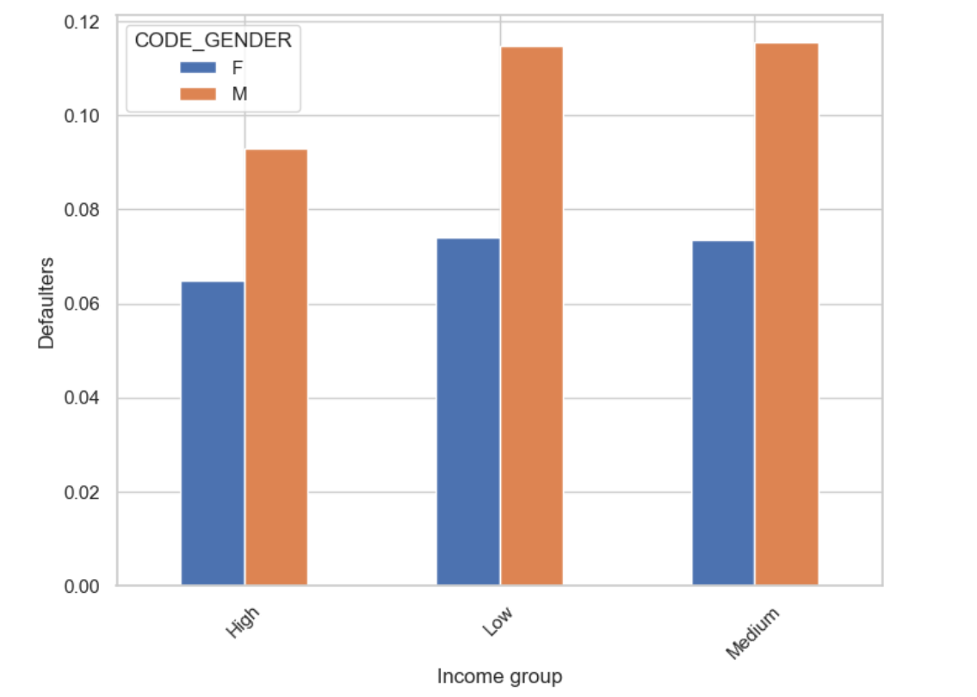
Conclusion:
- We can see that Males are more likely defaulted than Females accross all income groups
To target:
- Safer to target female for all income groups with higher income

Slide 7
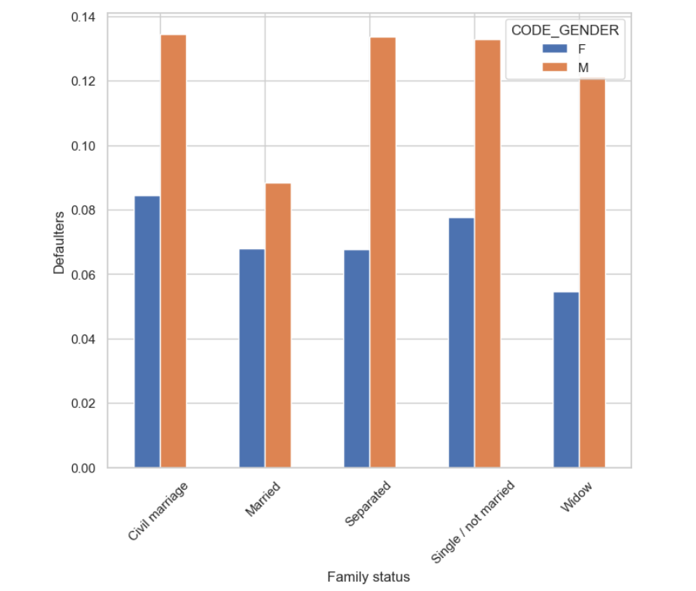
Conclusion:
- Across all family status the Male clients are more defaulted than Female.
To Target:
- Risky to grant loan for civil marriage, Single, Separated and Wedow

Slide 8
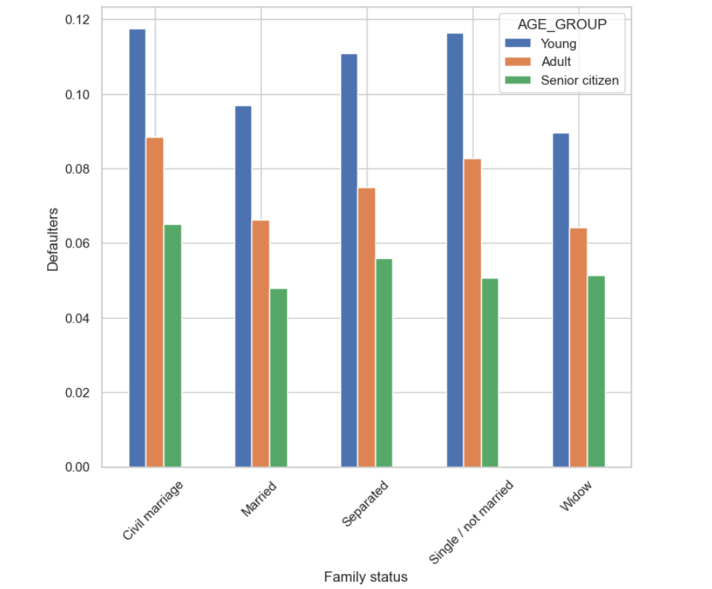
Conclusion:
- Across all family status the Young clients are more defaulted and Senior citizen are less.
To target:
- It is good to grant loan to Senior citizen of all family status

Slide 9
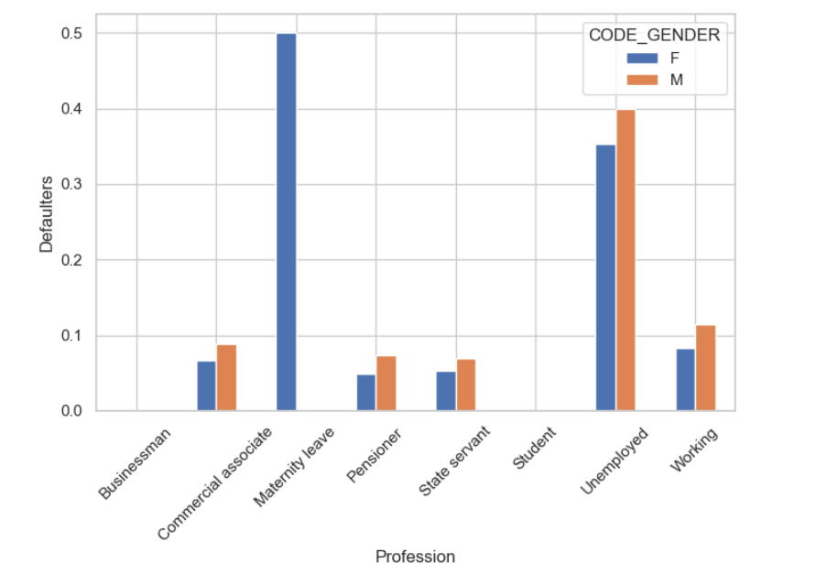
Conclusion:
- Unemployed clients are more defaulted
- Clients with maternity leave are expected to be defaulted more
- In all other professions the default rate is lesser
- Males are more defaulted with their respective professions compared to females
To target:
- Safe to grant loan to Pensioner and State servant

Slide 10
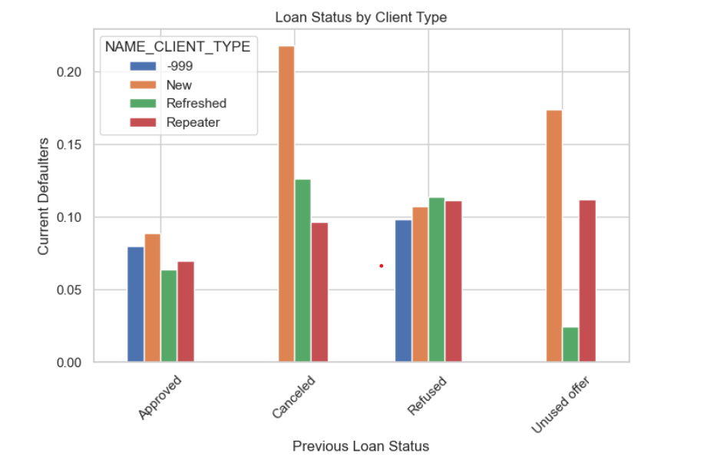
Loan application status Current and Previous
Conclusion:
- The data indicates a higher default rate among clients who were new and had unused offers in their previous loan status.
- New clients with previously approved statuses had a higher default rate, followed by repeat clients.
- Among applicants who were previously refused, those who were refreshed clients had a higher default rate.
- Similarly, new clients among previously canceled applicants showed a higher rate of default.
To target:
- It is not safe to grant loan for clients whose whose applications were Refused and Unused previously

Slide 11
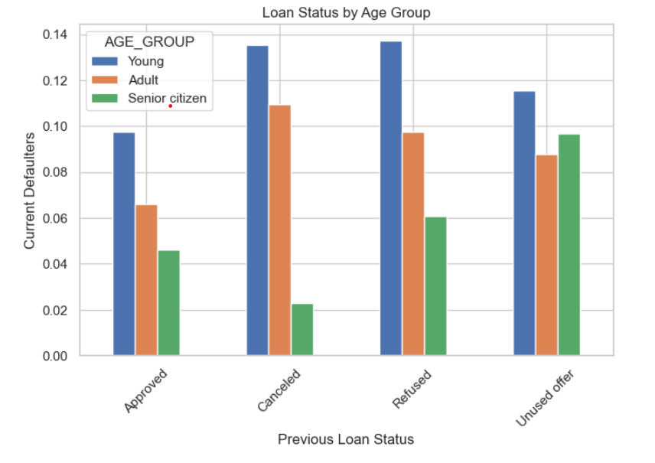
Conclusion:
- Higher number pf loans were refused to Young
- Among all type of agr groups, Senior citizen are less defaulter
To target:
- It is safe to grant loan to Senior citizens

Slide 12
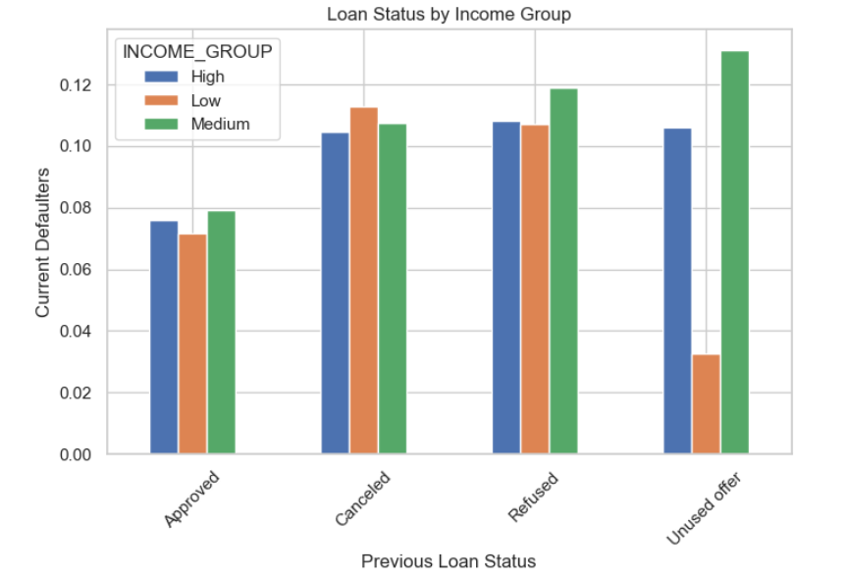
Conclusion:
- For Unused offers, Medium income group were more defaulted and Low income group were least
- For Aprooved, Medium income group were least defaulted among all
- It is almost similar for all income type of groups for Canceled loan status
To target:
- There is less risk to grant loan to Approved applicants to all groups

Slide 13
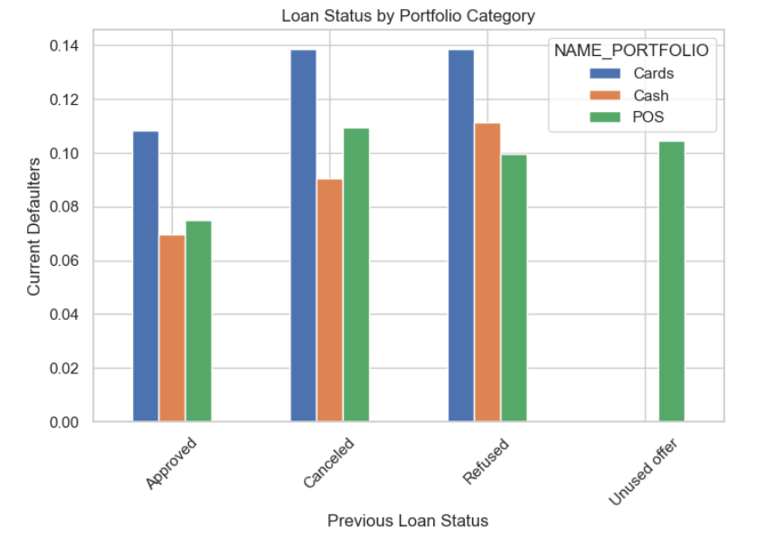
Conclusion:
- Most of defaulters clients were the one whose previous loan were for Cards
- Clients who applied for Cash were less defaulted
- Clients who applied for POS were less defaulted
To target:
- Safe to grant loan for any portfolio for previously approved applicants

Slide 14
Summary
Clients who must be Targeted:
- Clients who were accepted in their prior applications
- Individuals with advanced education and elevated income levels
- Customers with superior external source ratings
- Senior citizens across all groups
- Married applicants in contrast to those with different family statuses
- Females tend to be more favored compared to males.

Slide 15
Clients to whom Targeting is risky:
- Clients who were denied, had canceled offers, or unused offers in the past
- Individuals belonging to the low-income bracket who were previously rejected
- Customers without employment
- Those with unfavorable external source ratings
- Young clients pose a higher risk compared to adult and senior citizen clients
- Clients with lower secondary and secondary education levels

Slide 16
THANK YOU!

